Slide 1
Internet of Things
Mentored By :
Prof. Poonam Saini
Presented BY:
Aanshi Bansal

Slide 2

IoT Stories – Smart Building
Source : CISCO
https://www.youtube.com/watch?v=RmuEurPH9M4

Slide 3
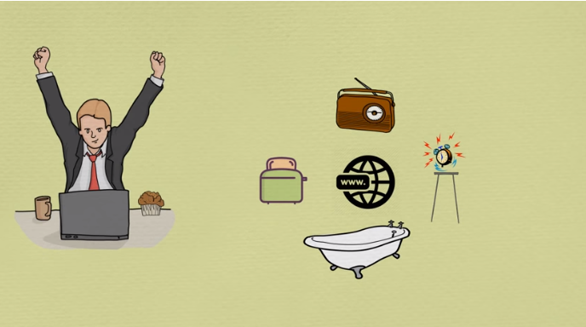
What would happen if your electronic devices start communicating with each other and with you as well ?
Source :
https://www.youtube.com/watch?v=MR_-tRnfFgs&t=52s

Slide 4
Contents
What is IoT ?
Building blocks of IoT
Why IoT ?
Applications of IoT
Future of IoT
Barriers to IoT Applications

Slide 5
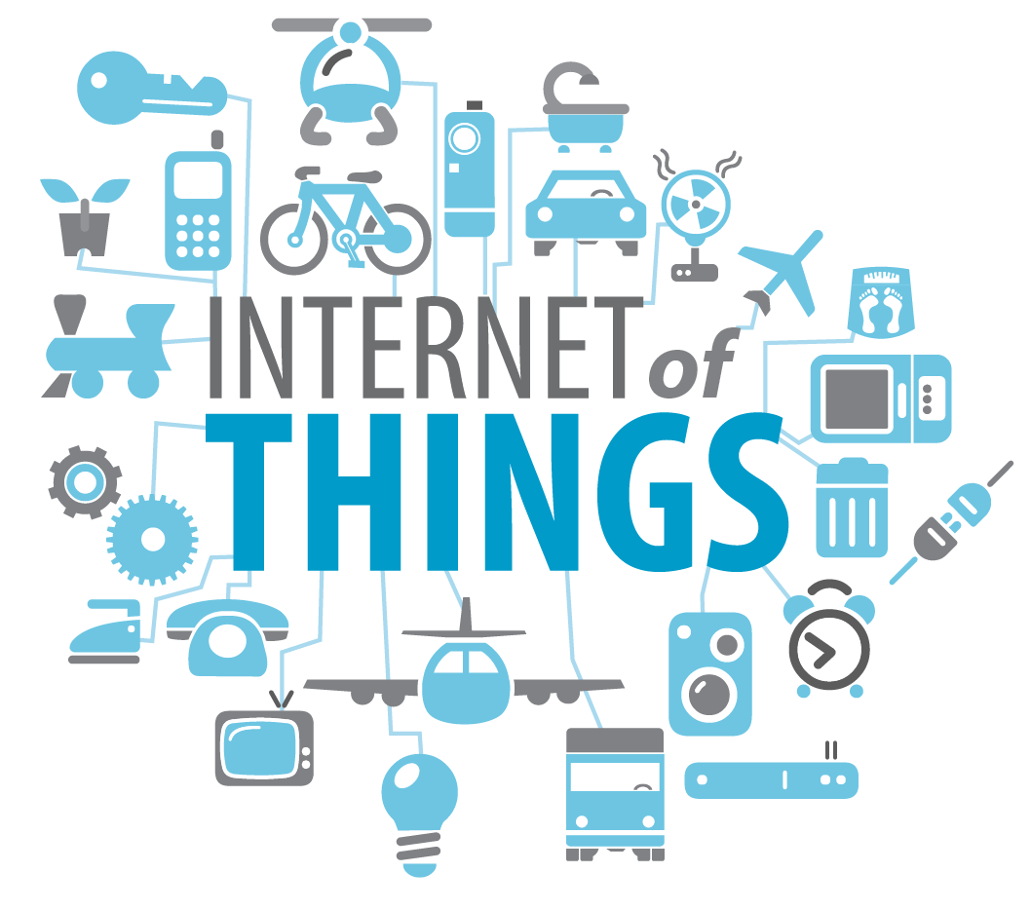

What is IoT ?
System of systems in which all electronic devices are connected to each other in a local area forming a system and these systems are further connected to form bigger network system
Source : https://www.coursera.org/learn/iot-cyber-security

Slide 6
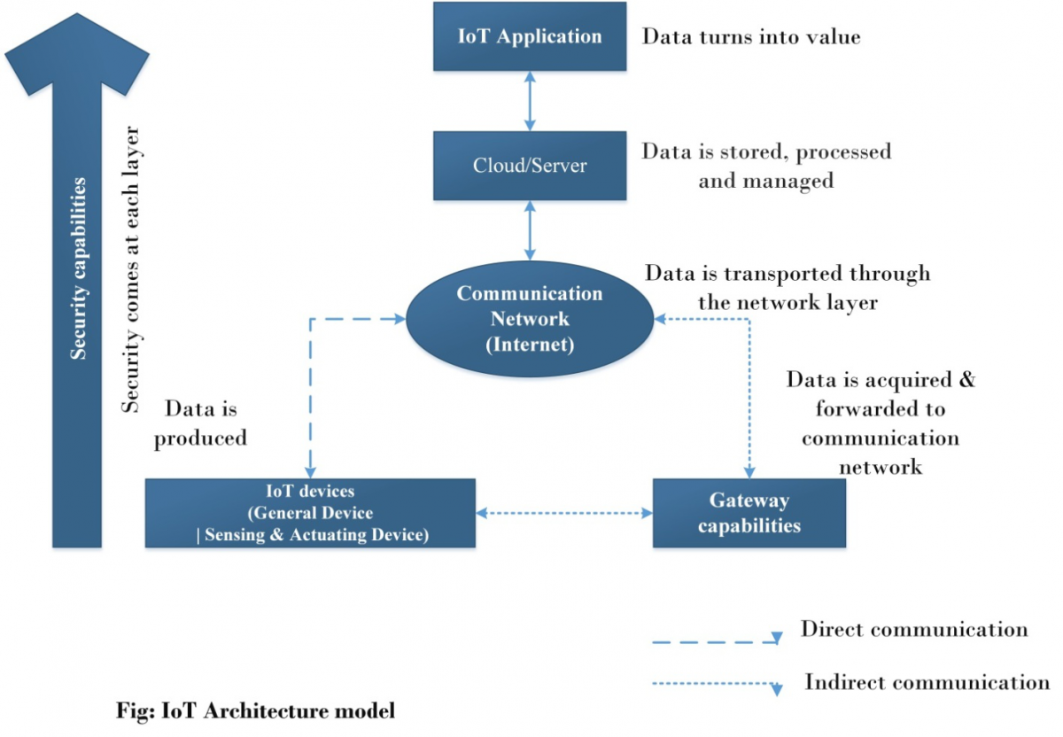
Building blocks of IoT
The basic architecture of an IoT system can be understood from a four-layer model as follow -
1) IoT devices and Gateways
2) Communication Network
3) Cloud or Server
4) IoT application
Source : https://www.engineersgarage.com/Articles/Internet-of-Things-Architecture

Slide 7
1) IoT Devices
Any device or equipment counts as an IOT device if it satisfies the following requirements -
It is capable of communicating with other devices and connect with an internet network.
It must be equipped with sensors and/or actuators. The sensors may be collecting static or dynamic information from the physical world.
The device must have a controller or processor to capture data, memory to store it (often temporarily) and firmware or operating system to process captured data or data received from the server or cloud.

Slide 8
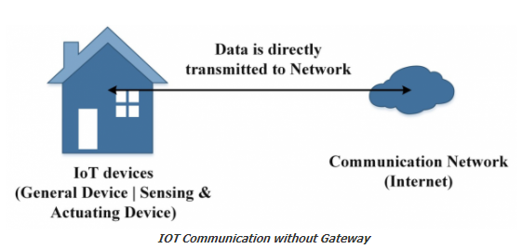
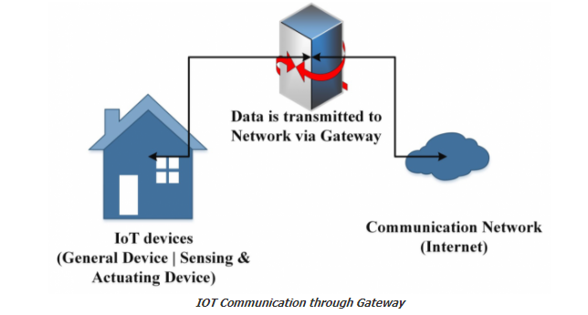
Gateways
Source : https://www.engineersgarage.com/Articles/Internet-of-Things-Architecture

Slide 9
2) Communication Network
The communication network is generally the typical internet network having different layers (Physical, Link, Network, Transport and Application) and communication protocols operating at different layers.

Slide 10
3) Cloud or Server
The cloud or server is the edge of the IOT system.
It is responsible for managing the connected devices and networks, manage device to device communications
Implement IOT applications by operating and synchronizing different IOT devices and communication between them.
The cloud may also communicate with other private and public cloud services to enable an IOT application.

Slide 11
4) IoT Application
The processing, mining and analysis of the data at the cloud is done by the IOT application.
The IOT application is the piece of software at the cloud server which extracts data, manipulate it to derive useful insights and manage to securely push insights to the target IOT devices.
For example, an IOT application designed for home automation might process data from sensors and send commands from the cloud to operate home appliances.

Slide 12
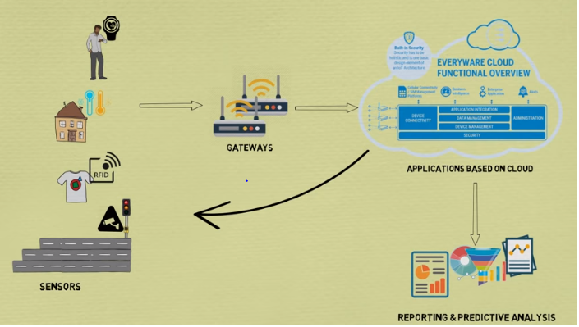
Source :
https://www.youtube.com/watch?v=MR_-tRnfFgs&t=52s

Slide 13
Why IoT ?
Objects will be able to speak to each other and do work for us, look after us.
Intelligent objects will improve our interaction with the environment
Since they are intelligent, they will do work on our behave, saving us from doing boring tasks
So we can concentrate on what we enjoy
Meanwhile objects collect data and take care of us
Saves money, do shopping and save us from waiting in big lines

Slide 14
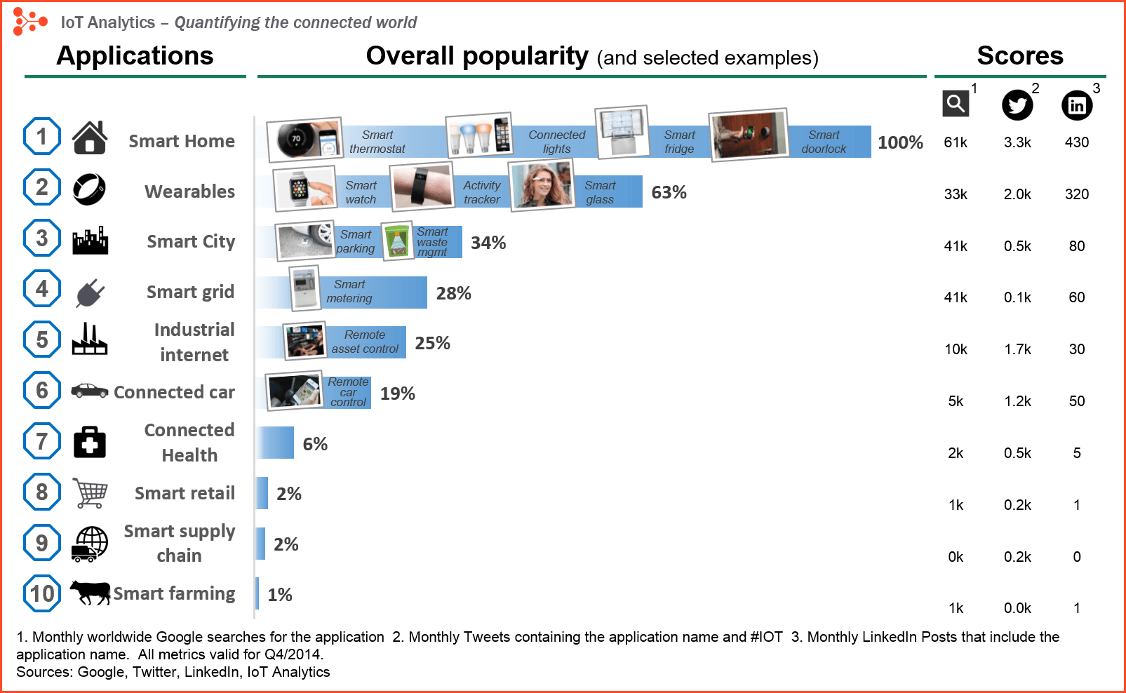
Applications of IoT
Source :
https://iot-analytics.com/10-internet-of-things-applications/

Slide 15
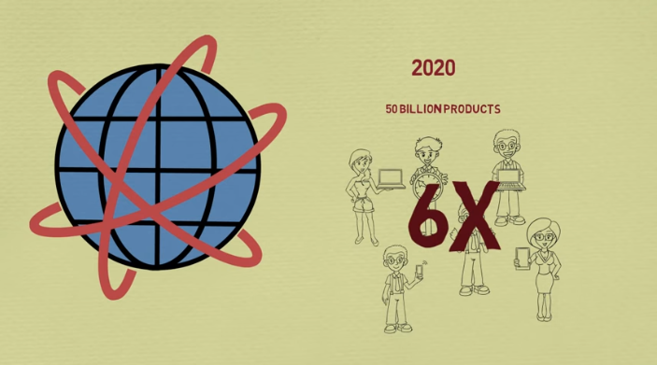
Future of IoT
By 2020 approx. 50 billion products will be connected to the internet that will be 6 times more equipment than that of the world’s would be population.
Very soon all the electronic devices produced will be IoT enabled. They will come with sensors and actuators. They will make our life more convenient and efficient.
Development scenario will completely depend on our needs, the creativity of the developer.
IoT is going to be big, very big and very soon hopefully not taking all the controls and steer the human race.
Source : https://www.youtube.com/watch?v=MR_-tRnfFgs&t=52s

Slide 16
Barriers to IoT Applications
Different standards
Lot of DATA – not known how to handle
Not everyone wants to share DATA
DATA selling
Security concern

Slide 17
References
https://www.youtube.com/watch?v=RmuEurPH9M4
https://www.youtube.com/watch?v=MR_-tRnfFgs&t=52s
https://www.coursera.org/learn/iot-cyber-security
https://www.engineersgarage.com/Articles/Internet-of-Things-Architecture
https://youtu.be/GIfWNtMfYvk
https://iot-analytics.com/10-internet-of-things-applications/

Slide 18
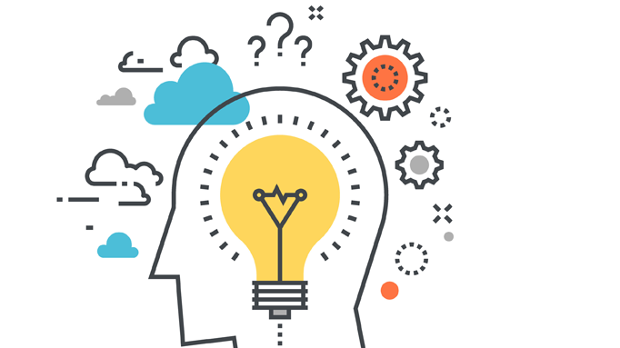
Questions please ?
Source :
http://www.brainfacts.org/thinking-sensing-and-behaving/thinking-and-awareness?page=3

